Slide 1
Stock Price Prediction

Slide 2
Abstract
This project uses Fourier analysis to test the effectiveness of mathematics in stock market trading.
Fourier transform is applied on the days vs stock price graph to find the cycles which have the most effect and analysis is done on those days to find out upcoming trends.
This could be very useful to remind traders to keep a look at those time intervals so that they do not miss out on trends.

Slide 3
Introduction
Stock trading is a process where the trader tries to buy a share(part) of a company at a lower price to sell it at a higher price expecting to make profits out of it.
However, this is not that simple as the price of a stock generally is volatile in nature.
It is difficult to predict if the price goes up or down.
There are chances that the trader makes a loss if the stock price decreases due to market conditions.
Due to the above-said reasons, the trader has to keep a look at the stock prices always.

Slide 4
Problem
It is not always possible to monitor each stock in the portfolio always as there may be multiple stocks in a portfolio.
This project aims to reduce those efforts by predicting when the stock movement might occur and alerting the trader to check out the stock.
This could significantly reduce the time the trader requires to monitor the stock price and make the trader more efficient.

Slide 5
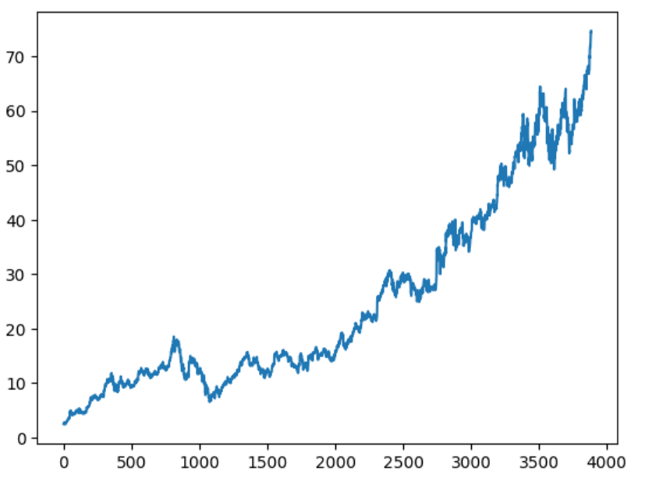

Data Collection
The stock price data used for analysis is of Google stock which has the ticker “GOOGL”. The everyday open prices are considered from 1st January 2000 to 25th January 2022. The open prices when plotted over time are shown below

Slide 6

Data Collection - Data source
The data from Yahoo Finance has been used for this project. Yahoo Finance is a popular and trusted repository where many investors and analysts conduct analyses. All the data provided is real, accurate and monitored by the stock exchanges.
The stock data over a minimum of 2 years had been selected. There are no legal restrictions to using this data.

Slide 7
Standardization - exponentiality reduction
As we can see, this graph looks like a exponential graph. This is because all the natural growths happen exponentially. However fourier transform performs the best if the graph looks more like a wave. Therefore, we reduce the graph’s exponentility by applying log function to it. The expectation is that it will create a linearly increasing wave, so that when we rotate the increasing wave, we will get a wave oscillating over x-axis. The graphs looks as follows after applying logarithmic function.

Slide 8
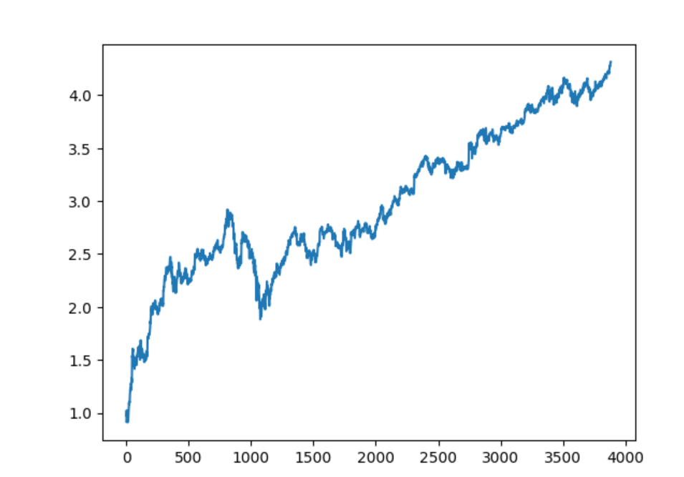

Slide 9
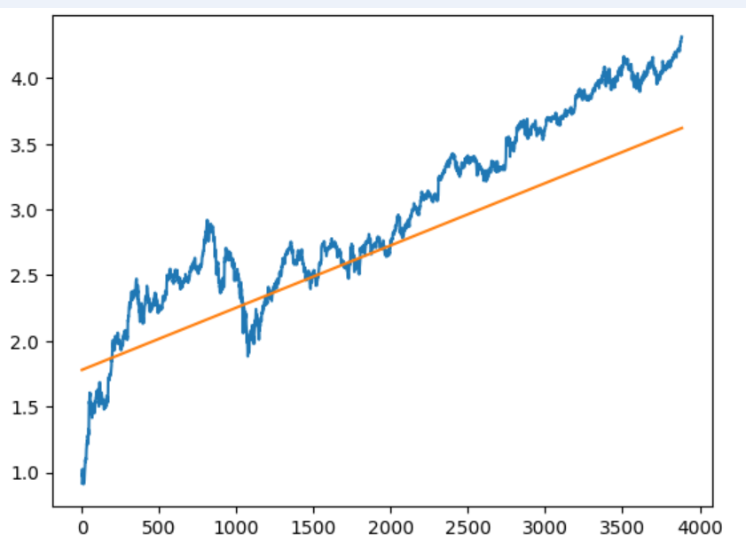
Standardization -
We can now fit a line passing through this increasing wave. The line looks as shown below.

Slide 10
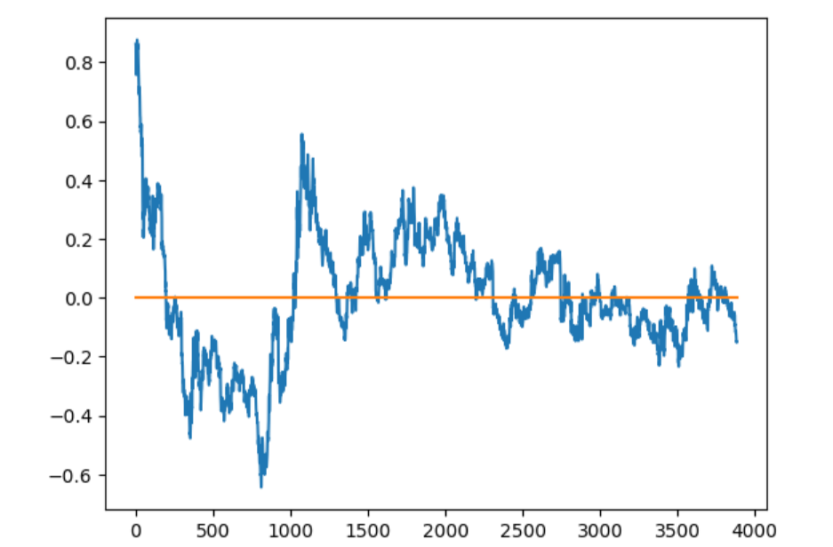
Standardization - reduction of increasing nature
Rotate the x-axis to this newly obtained line. We can do this by finding the perpendicular distances of points from this line and taking them as y values. The resulting wave is as show below

Slide 11
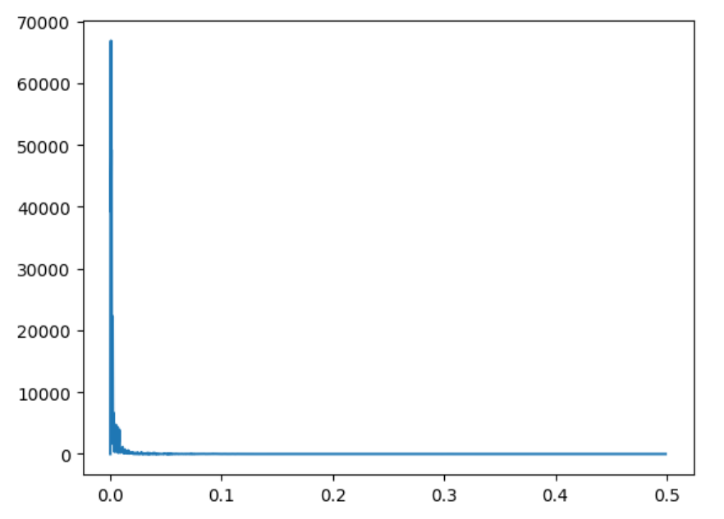
Fourier Transform
Applying Fourier transform, we get the intensity vs frequency graph as shown below

Slide 12
Fourier Analysis
When we filter the frequencies with a threshold, we found out lower frequencies like 8 days, 11 days etc showed good intensity.
This is expected because the stock prices often fluctuate to lower frequent days due to market sentiments.
We can choose a dominating frequency (11 days in our case) and split the wave in intervals of 11 days.
This way we know the data within this 11 day period is dependent.

Slide 13
Model
The dataset prepared has scaled stock prices as x and y. We create an LSTM which takes stock prices of the last 11 days and predicts the next day’s stock price.

Slide 14
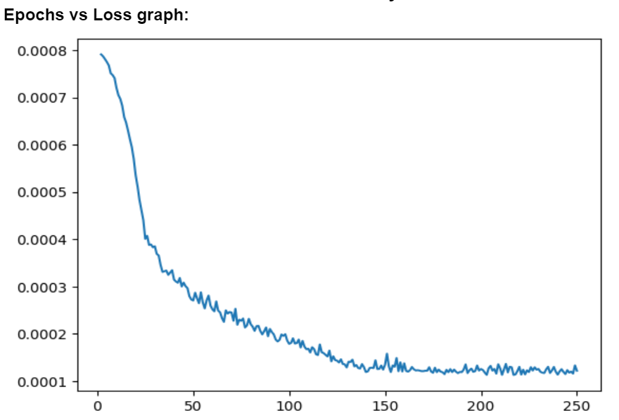
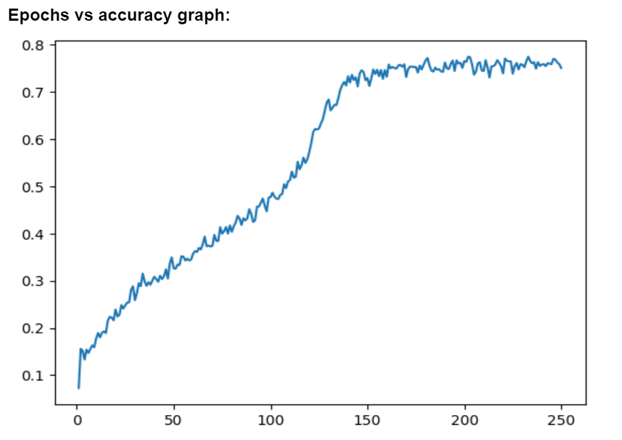
Results

Slide 15
Conclusion
We observe the most of the existing projects do not use standardization, they rather apply fourier analysis directly. However, after using the standardization methods we observe that we are able to obtain pretty good results.
However, as the stock price is influenced by various external factors, we can not solely depend upon the ML model for investments. It is recommended to use these models for a initial idea and perform further due diligence before actually placing the order.

